Slide 1
Object Oriented Programming

Slide 2
Course Contents
Classes
The Self
Methods
The 'init'
Polymorphism
Data Encapsulation / Abstraction
Inheritance

Slide 3
Object Oriented Programming
In all the programs we wrote till now, we have designed our program around functions i.e. blocks of statements which manipulate data. This is called the procedure-oriented way of programming.
There is another way of organizing program which is to combine data and functionality and wrap it inside something called an object.
This is called the object oriented programming paradigm.
Most of the time one can use procedural programming, but when writing large programs or have a problem that is better suited to this method, you can use object oriented programming techniques.

Slide 4
Object Oriented Programming
Classes and objects are the two main aspects of object oriented programming.
A class creates a new type where objects are instances of the class.
An analogy is that you can have variables of type int which translates to saying that variables that store integers are variables which are instances (objects) of the int class.
Fields are of two types - they can belong to each instance/object of the class or they can belong to the class itself. They are called instance variables and class variables respectively.
A class is created using the class keyword.
The fields and methods of the class are listed in an indented block.

Slide 5


Classes
We create a new class using the class statement and the name of the class. This is followed by an indented block of statements which form the body of the class. In this case, we have an empty block which is indicated using the pass statement.
Next, we create an object/instance of this class using the name of the class followed by a pair of parentheses.

Slide 6
Classes
For our verification, we confirm the type of the variable by simply printing it.
It tells us that we have an instance of the Person class in the main module.
Notice that the address of the computer memory where your object is stored is also printed.

Slide 7
The self
Class methods have only one specific difference from ordinary functions - they must have an extra first name that has to be added to the beginning of the parameter list, but you do not give a value for this parameter when you call the method, Python will provide it.
This particular variable refers to the object itself, and by convention, it is given the name self .
Although, you can give any name for this parameter, it is strongly recommended that you use the name self - any other name is definitely frowned upon.
There are many advantages to using a standard name - any reader of your program will immediately recognize it and even specialized IDEs (Integrated Development Environments ) can help you if you use self .
Notes:
Frown - furrow one's brows in an expression indicating disapproval, displeasure, or concentration.

Slide 8
The self
How Python gives the value for self and why we don’t need to give a value for it.
Let us have a class called List and an instance of this class called shoplist.
When we call a method of this object as shoplist.append(‘milk’), this is automatically converted by Python into List.append(shoplist, ‘milk’) - this is all the special self is about.
This also means that if you have a method which takes no arguments, then you still have to have one argument - the self .
The self in Python is equivalent to the this pointer in C++ and the this reference in Java and C#.

Slide 9

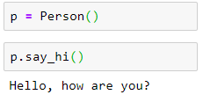

Methods
Classes/objects can have methods just like functions except that we have an extra self variable.
We see the self in action in given example.
Notice that the say_hi method takes no parameters but still has the self in the function definition.

Slide 10


The init method
There are many method names which have special significance in Python classes.
The init method is run as soon as an object of a class is instantiated.
The method is useful to do any initialization you want to do with your object.
Notice the double underscores both at the beginning and at the end of the name.
We do not explicitly call the init method but pass the arguments in the parentheses following the class name when creating a new instance of the class.

Slide 11
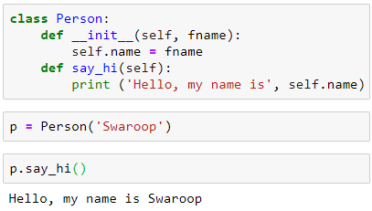
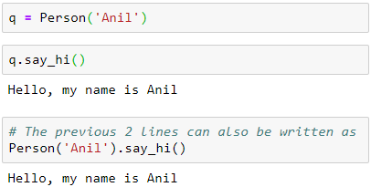
The init method

Slide 12
Polymorphism
Polymorphism is achieved through method overloading. Method overloading means there are several methods present in a class having the same name but different types/number of parameters. Like other languages , python does not supports method overloading by default. But there are different ways to achieve polymorphism in Python.
Polymorphism is an ability (in OOP) to use common interface for multiple form (data types). Suppose, we need to color a shape, there are multiple shape option (rectangle, square, circle). However we could use same method to color any shape. This concept is called Polymorphism.

Slide 13
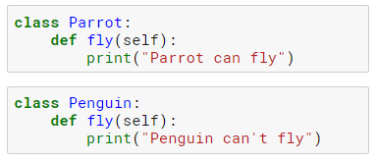
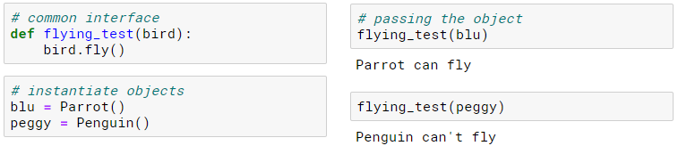
Polymorphism
In the given program, we will define two classes Parrot and Penguin. Each of them have common method fly() method. However, their functions are different.
To allow polymorphism, we create common interface flying_test() function that can take any object. If we pass the objects blu and peggy in the flying_test() function, it run effectively.

Slide 14
Data Encapsulation / Abstraction
Abstraction is an important aspect of object-oriented programming.
In python, we can perform data hiding by adding the double underscore (_ _) as a prefix to the attribute which is to be hidden. After this, the attribute will not be visible outside of the class through the object.
Using OOP in Python, we can restrict access to methods and variables. This prevent data from direct modification which is called encapsulation.
We defined a class Computer. We use __init__() method to store the maximum selling price of computer. We try to modify the price. However, we can’t change it because Python treats the __maxprice as private attributes.
To change the value, we used a setter function setMaxPrice() which takes price as parameter.
Notes:
Data abstraction refers to providing only essential information about the data to the outside world, hiding the background details or implementation.

Slide 15
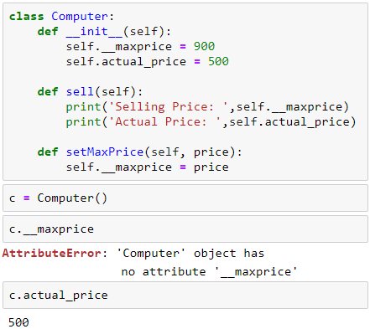
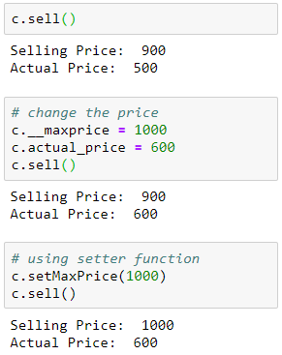
Data Encapsulation / Abstraction

Slide 16
Inheritance
One of the major benefits of object oriented programming is reuse of code and one of the ways this is achieved is through the inheritance mechanism.
Inheritance can be best imagined as implementing a type and subtype relationship between classes.
Suppose you want to write a program which has to keep track of the teachers and students in a college. They have some common characteristics such as name, age and address. They also have specific characteristics such as salary, courses and leaves for teachers and, marks and fees for students.
You can create two independent classes for each type and process them but adding a new common characteristic would mean adding to both of these independent classes. This quickly becomes unwieldy.
Notes:
Unwieldy = disorganised

Slide 17
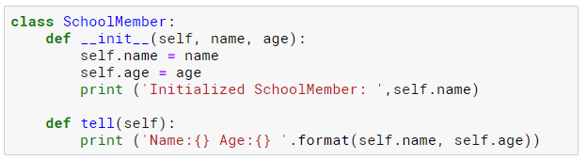
Inheritance
A better way would be to create a common class called SchoolMember and then have the teacher and student classes inherit from this class i.e. they will become sub-types of this type (class) and then we can add specific characteristics to these sub-types.
There are many advantages to this approach.
If we add/change any functionality in SchoolMember , this is automatically reflected in the subtypes as well.

Slide 18
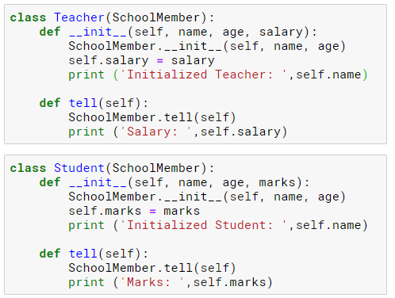
Inheritance
Also observe that we reuse the code of the parent class and we do not need to repeat it in the different classes as we would have had to in case we had used independent classes.
The SchoolMember class in this situation is known as the base class or the superclass.
The Teacher and Student classes are called the derived classes or subclasses.

Slide 19
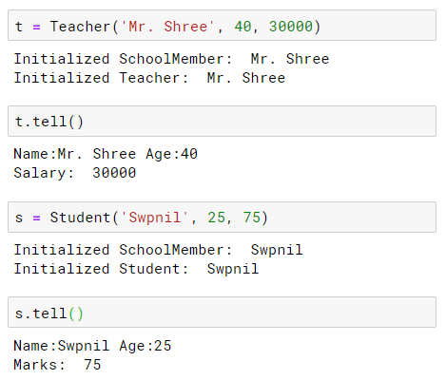
Inheritance

